Slide 1
DISARM Milestone 5 Second Semester
Debris In Space Autonomous Removal Mechanism
3/19/2020
Notes:
Lets get it

Slide 2
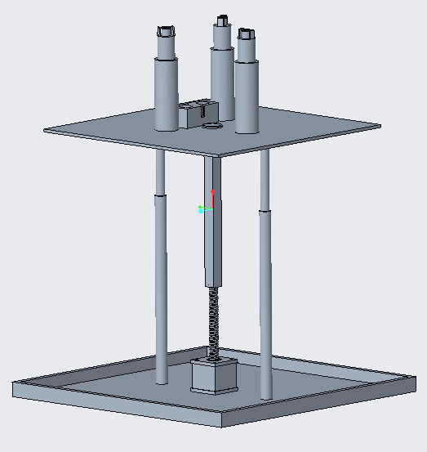
Content
MILESTONE TASKS
UPDATED SYSTEM DIAGRAM
SIMULATION DEMO
FORWARD WORK

Slide 3
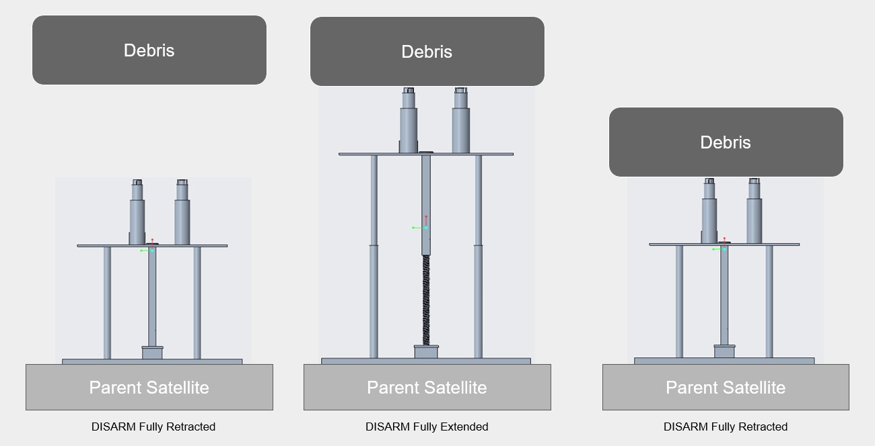
Client: Dr. Markus Wilde Advisor: Dr. Marius Silaghi

Slide 4
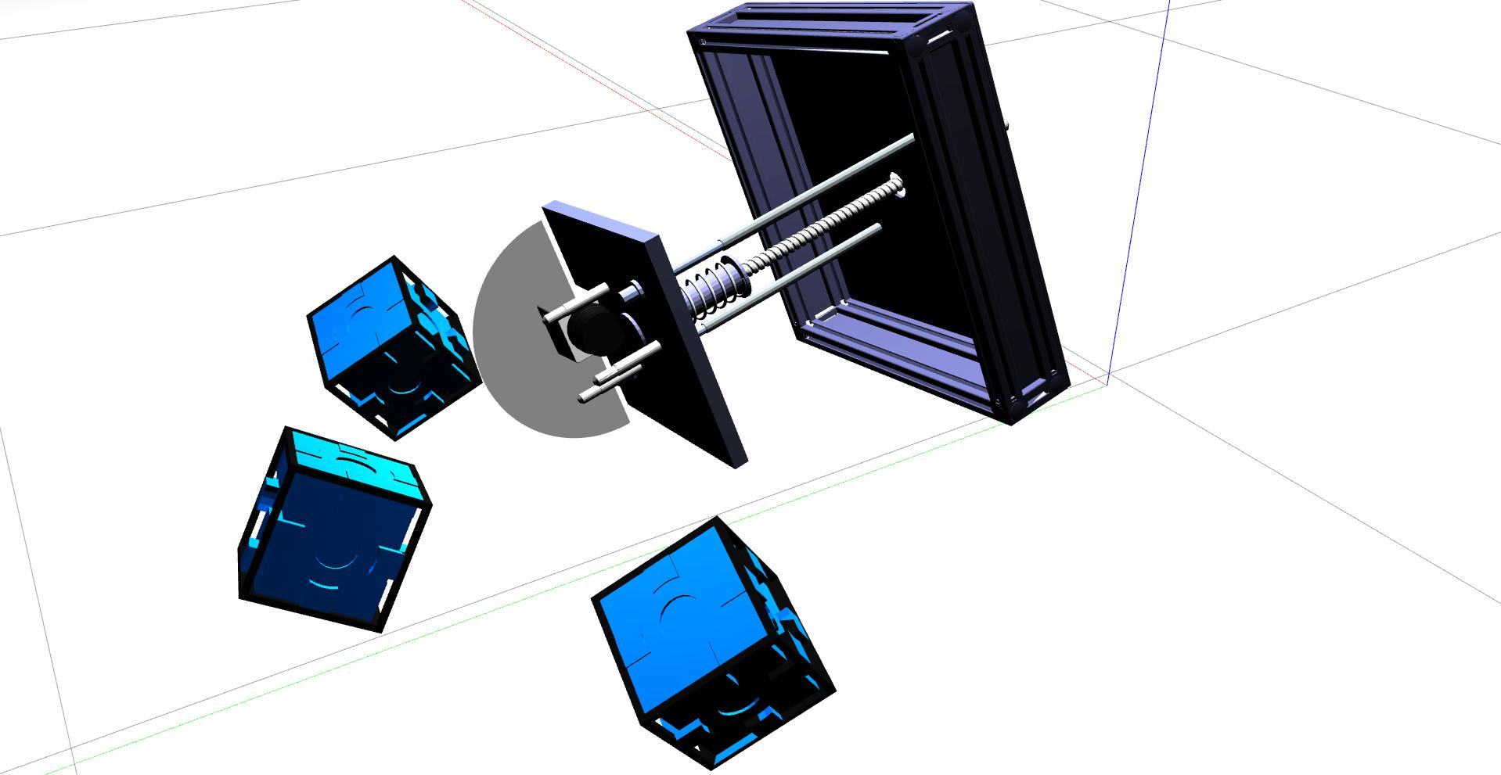
MILESTONE TASKS
1) Finish developing DISARM plugin (Completed)
2) Develop demo videos (1/3 Completed)
3) Create poster for showcase (In progress)

Slide 5
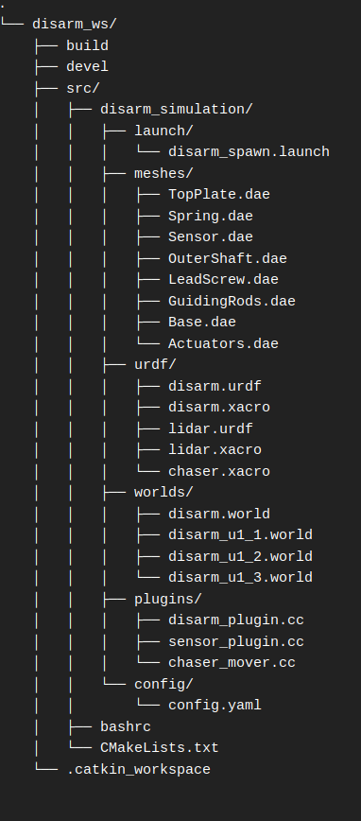
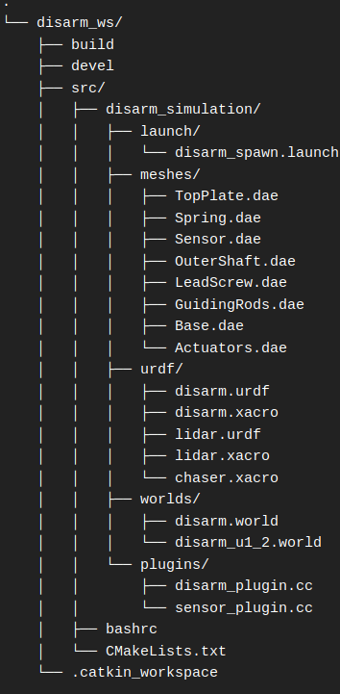
UPDATED SYSTEM DIAGRAM

Slide 6

SIMULATION DEMO

Slide 7
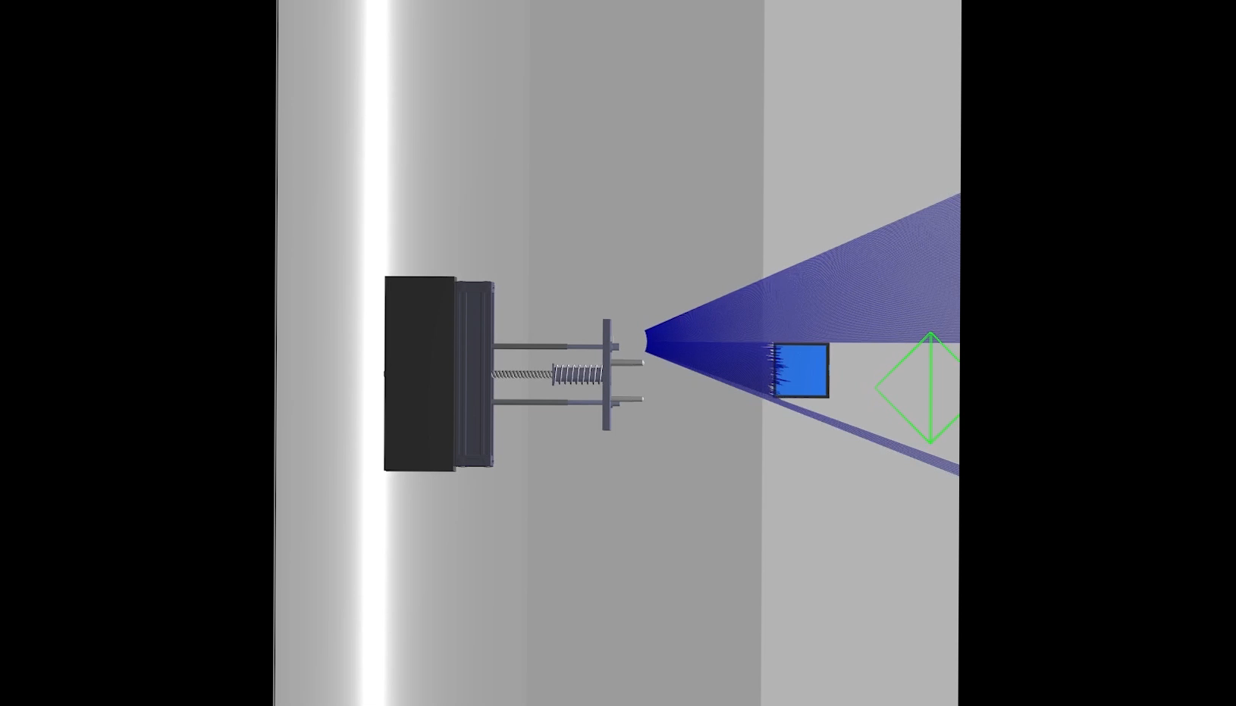
SIMULATION DEMO

Slide 8
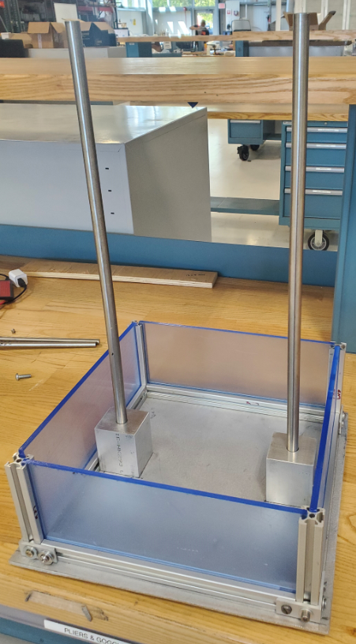
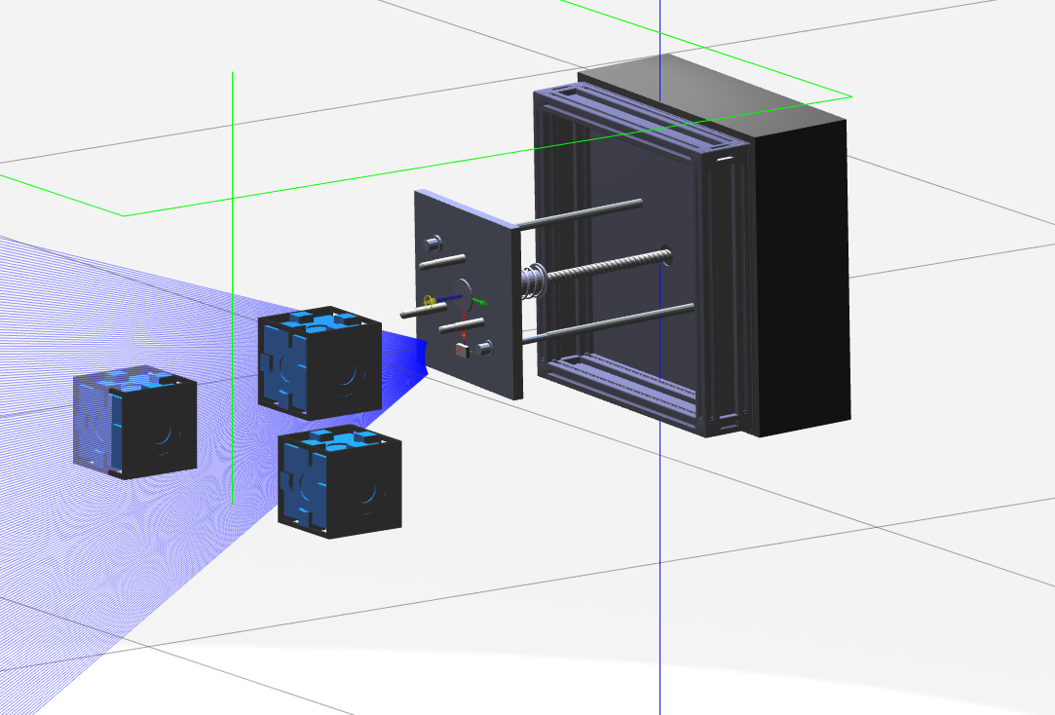
FORWARD WORK (MILESTONE 6)
Finish recording demo videos (6U, 26U, multiple debris?)
Design poster and e-book with team
Help control systems lead with testing
motor code once it arrives.

Slide 9
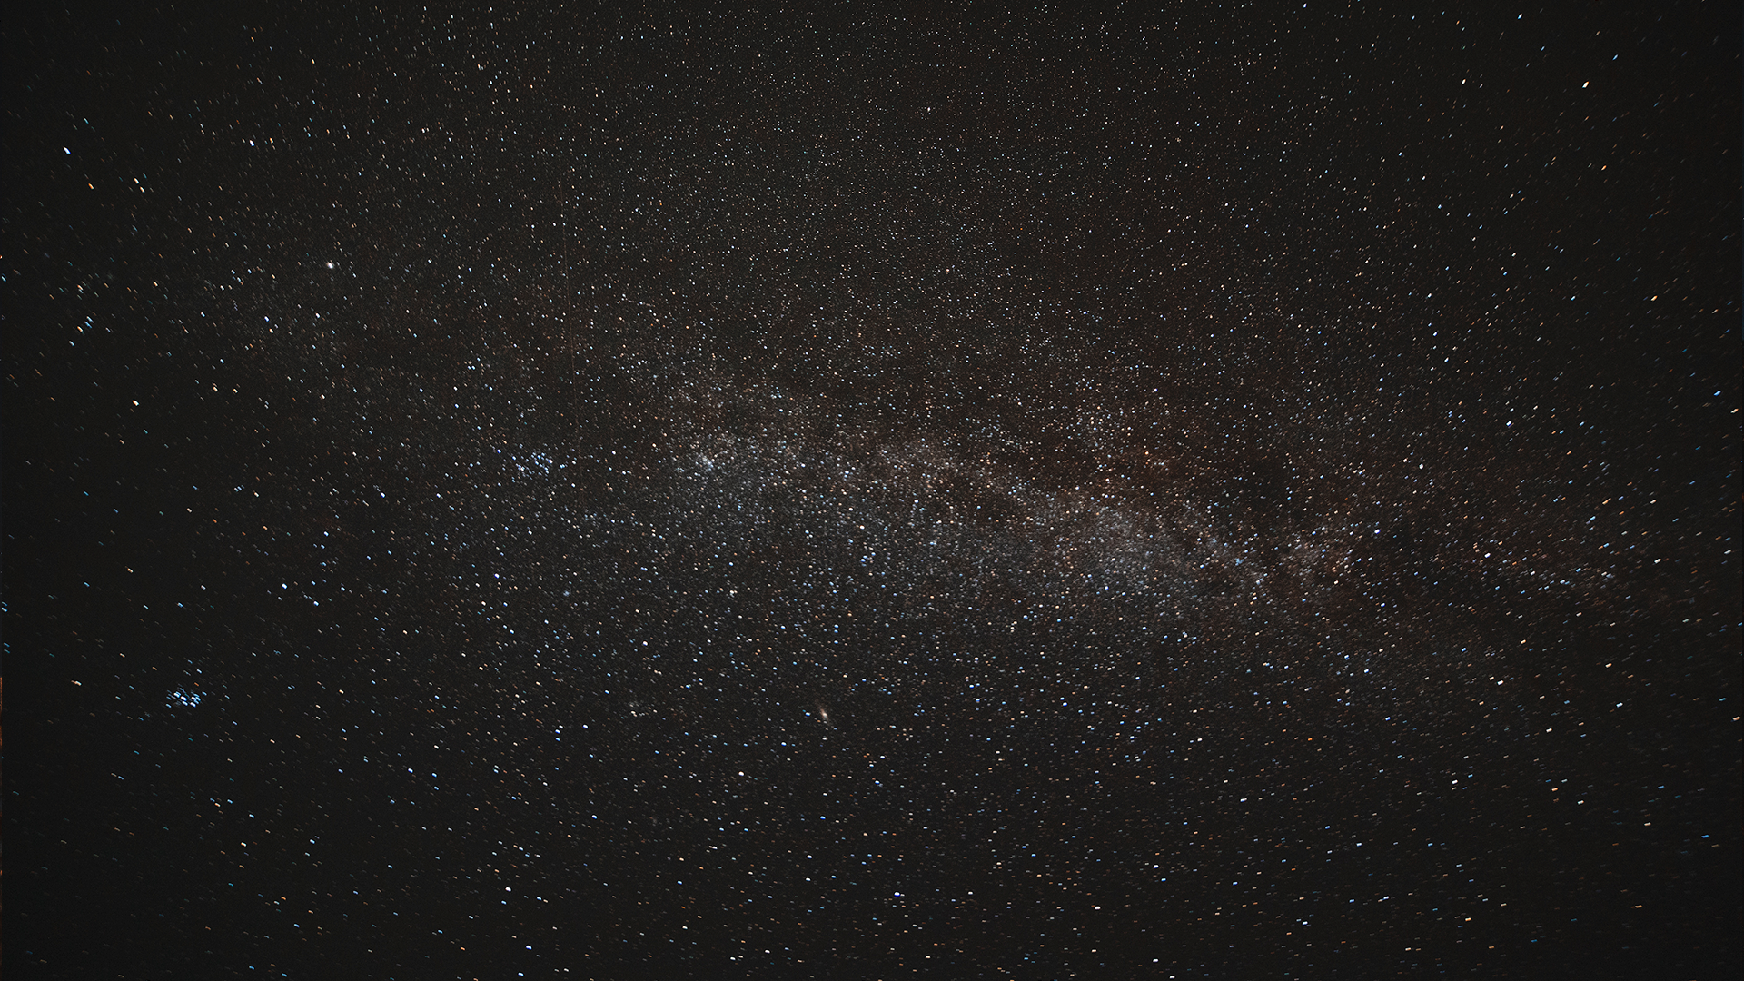

THANK YOU!
Any Questions?
Kyle Watkins, Project Manager
watkinsk2017@my.fit.edu
Luca Rizza, Systems Engineer
lrizza2017@my.fit.edu
Laura Guziczek, Engineer
lguziczek2018@my.fit.edu
Michael Leard, Engineer
mleard2017@my.fit.edu
Ali Lebbar, Engineer
alebbar2016@my.fit.edu
Davey Renoid, Engineer
drenoid2016@my.fit.edu
Matthew Intriago, Computer Science
mintriago2017@my.fit.edu
Vincent Panichelli, Engineer
vpanichelli2017@my.fit.edu
Daniel Soto, Engineer
dsotoperezco2017@my.fit.edu
Nouraldean El-Chariti, Engineer
nelchariti2017@my.fit.edu

